Slide 1
Slaviša Đurđić
Home Sales from 1963 to 2016 in the United States
Goal: Analysis of the Tableau “U.S. Home Sales, 1963-2016” government data sample dataset with Looker Studio.
Instructions:
- Collect data by downloading the CSV file from https://public.tableau.com/app/learn/sample-data?qt-overview_resources=1#qt-overview_resources.
- Connect to the file from Looker Studio and build visuals (https://lookerstudio.google.com/reporting/a1bc40e5-53c5-4355-8b86-33376083109c/page/jSoeD).
Belgrade, October 2023

Slide 2
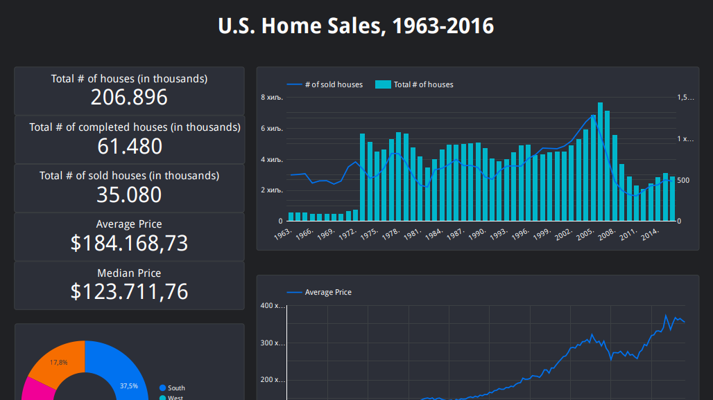

Slide 3
Home sale price had been increasing over time. Average price for the period 1963-2016 was $184.168,73.
Median of home sale price for the period 1963-2016 was $123.711,76.
Total number of sold houses during the period 1963-2016 was 35.080 thousands.
Total number of completed houses during the period 1963-2016 was 61.480 thousands.
The most houses for the period were sold on the south of the United States (=37.5%).
Home Sales Project Insights

